Slide 1
Agenda
Welcome
Housekeeping
Frequently Asked Questions (FAQ)
Operational
Logistical Support
Financial
Accessing your ReadyAlert Account

Slide 2
Q: What is ReadyAlert’s role in the Neighbors-Saving-Neighbors (NSN) program?

Slide 3
Delivers cardiac arrest alerts to responder’s devices.

Slide 4
Sends general test alerts.

Slide 5
Works closely with the group coordinator to maintain a current notification database;

Slide 6
Works closely with Public Safety and the coordinator in assisting new groups joining the NSN program.

Slide 7
OPERATIONAL

Slide 8
Q: Who decides the event is a cardiac arrest?

Slide 9
A: 911 Dispatcher determines the event is a cardiac arrest based on the information provided.

Slide 10
Cardiac Arrest = NON-BREATHING.

Slide 11
Determination can be immediately or during the call. EMS will be dispatched prior to determination.

Slide 13
Q: What is the role of a group coordinator?

Slide 14
A: Maintain a current list of trained responders; notify ReadyAlert Support of any changes in database.

Slide 15
A: Have responders confirm receipt of test alerts.

Slide 16
A: Coordinate live cardiac arrest drill(s).

Slide 17
A. Contact Public Safety for batteries and pads; monitor AED’s and cabinets.

Slide 18
A. Facilitate training and re-training for their responders.

Slide 19
NEED INFORMATION?
Go to
http://www.readyalertaed.com/

Slide 20


Slide 21
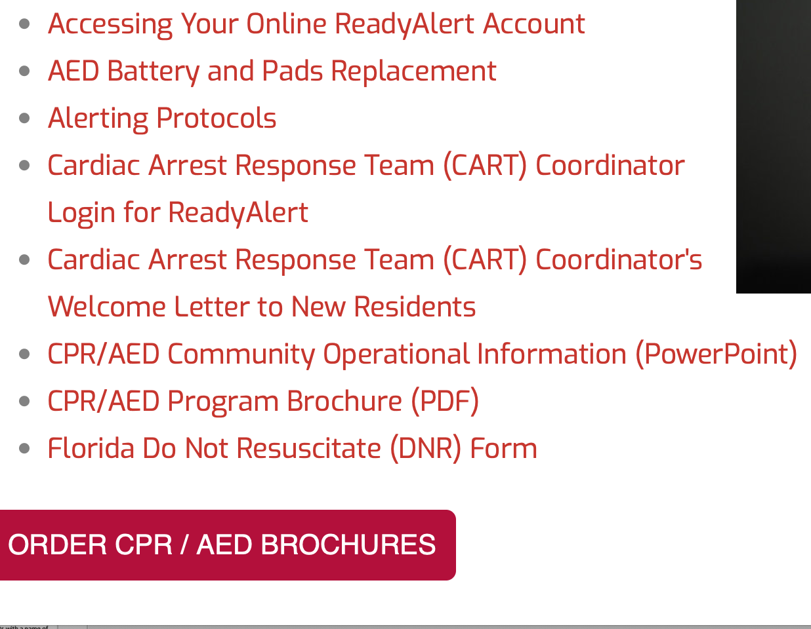

Slide 22
Q: Are responders required to be re-trained every two years?

Slide 23
A: No. Recommended but not required.

Slide 24
Q: After group responders are initially trained by Public Safety, how are new responders trained and current responders re-trained?
Notes:
John and or Norm

Slide 25
A: Through Public Safety at $25 each;
Notes:
John and or Norm

Slide 26
- Coordinator - at no cost by using CPR/AED training kit that was initially provided by Public Safety;
Notes:
John and or Norm

Slide 27
Free by contacting The Villages CERT at https://certofthevillages.
org
Notes:
John and or Norm

Slide 28
Through ReadyAlert for $10 each – contact Martha Mitchell @ marthamitchell17825
@gmail.com
Notes:
John and or Norm

Slide 29
Q: What telephone numbers are associated with a VOICE alert?

Slide 30
A: (866) 418-0641
(866) 418-6183

Slide 31
- This number should be entered into contacts with a name of CARDIAC ARREST and a unique ring tone selected.

Slide 32
- If the “do not disturb feature” is used on the phone, make sure this contact is saved as a “favorite.”

Slide 33
- If not, the phone will not ring when there is an alert.

Slide 34
Q: What ID number is associated with a text alert?

Slide 35
A: It is a random number and should not be saved.

Slide 36
Q: Should responders have voice and text on their cell phone?

Slide 37
A: Yes. With voice, the phone rings and can be used as an “alarm.”

Slide 38
- With text, the phone only tones once, but the message can be easily read. Important to have phone on at night.

Slide 39
Q: Should responders confirm general test alert to ReadyAlert?

Slide 40
A: No. We recommend that they confirm receipt of the test alert to their group coordinator or designee.

Slide 41
Q: What should a coordinator do if notified by a responder that he/she did not receive a test alert?

Slide 42
A: Go to www.readyalertaed.com and click on Support (upper right-hand corner of page).

Slide 43
On Navigation Bar

Slide 44
- Complete and submit the support ticket. Provide the responder(s) name(s) for retest.

Slide 45
Q: Should responders have an email address?

Slide 46
A: It is not necessary. Coordinators have an email address in their record so that they have a record of all alerts sent.

Slide 47
After November 2020, we do not request email addresses for responders.

Slide 48
Q: Can a responder reply back to a text alert?

Slide 49
A: Yes, but it is not necessary unless the coordinator is accessing his/her RA account to view confirmations.

Slide 50
Q: Can a coordinator make changes to their group data?

Slide 51
A: No. The system is read-only. Email support for changes.

Slide 52
Q: Should cardiac arrest drills be held?

Slide 53
A: It is highly recommended that a cardiac arrest drill be held at least once a year.

Slide 54
- Important to know the responder’s physical readiness and equipment condition.

Slide 55
- a practice drill re-energizes the group. Complacency diminishes readiness, program awareness and fund raising.

Slide 56
Cardiac Arrest Drill – scheduled through ReadyAlert

Slide 57
Q: How are cardiac arrest drills through ReadyAlert scheduled?

Slide 58
A: Contact support with date, time and complete address including Zip Code.

Slide 59
A: Alert time is scheduled by 15-minute increments, e.g. 6:00, 6:15, 6:30, 6:45, etc.

Slide 60
- Do not schedule more than one week prior.

Slide 61
- All activated responder household (Primary and Alternate) will be sent the alert.

Slide 62
Q: Can suspended responder household be included?
A: YES

Slide 63
- When a cardiac arrest drill is requested through Support.

Slide 64
- include the name(s) of an Alternate(s) and/or suspended household(s).

Slide 65
Q: Where should responders park when arriving at the cardiac arrest alert location?
Notes:
John and/or Norm

Slide 66
A: Park on the grass or the neighbor’s driveway not on the street or in the driveway.
Notes:
John and/or Norm

Slide 67
- The area that needs to be open is the street (both sides) and the driveway.
Notes:
John and/or Norm

Slide 68
- This area needs to be open for at least one fire engine (34.5’) one ambulance (14’) and one rescue (14’).
Notes:
John and/or Norm

Slide 69
Notes:
John and or Norm

Slide 70
Q: When the person who is with the patient states that there is a DNR, does the responder(s) take their word for it?
Notes:
John and/or Norm

Slide 71
A: Yes. Respect the wishes of the family member.
Notes:
John and/or Norm

Slide 72
Q: How does HIPPA impact what information that can be made public about an event?
Notes:
John and/or Norm

Slide 73
A: HIPPA - Acronym that stands for the Health Insurance Portability and Accountability Act, a US law designed to provide privacy standards to protect patients' medical records and other health information provided to health plans, doctors, hospitals and other health care providers.
Notes:
John and/or Norm

Slide 74
Although your group is not subject to HIPPA, it is recommended that you first clear any information about the event with the family prior to publicly releasing any information.
Notes:
John and/or Norm

Slide 75
Q: Can a responder be sued for aiding assistance?
A: No. Volunteers fall under the Florida Good Samaritan Act.
Notes:
John and/or Norm

Slide 76
Q: Will a map option appear on cell phone?
A: Yes and No. Depends on phone manufacturer and carrier
Notes:
John and/or Norm

Slide 77
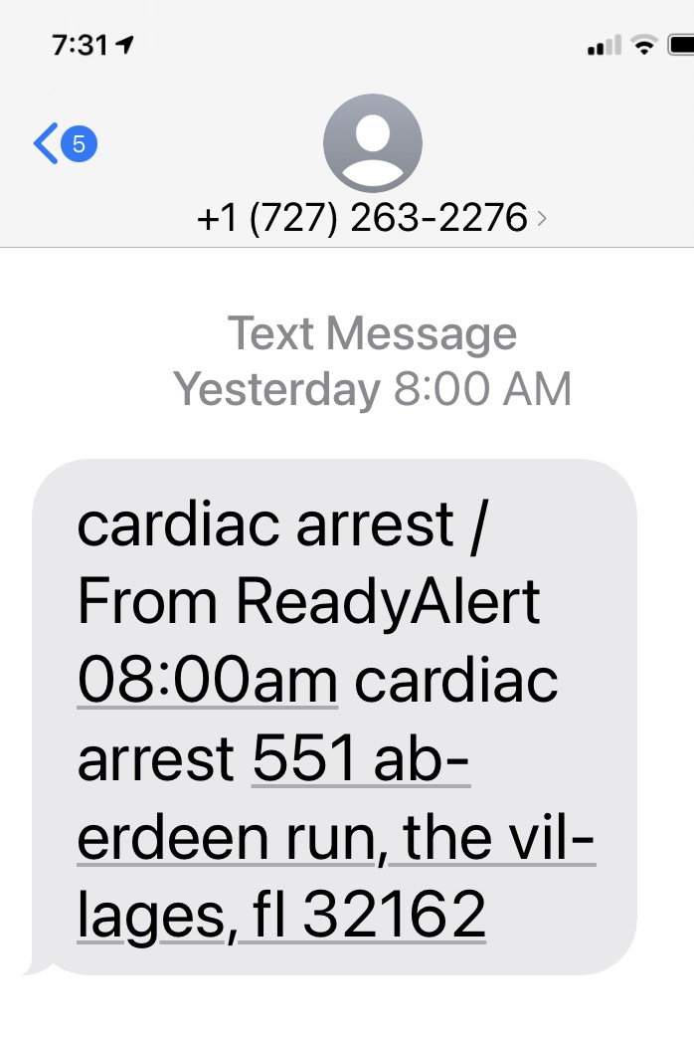
TEXT

Slide 78
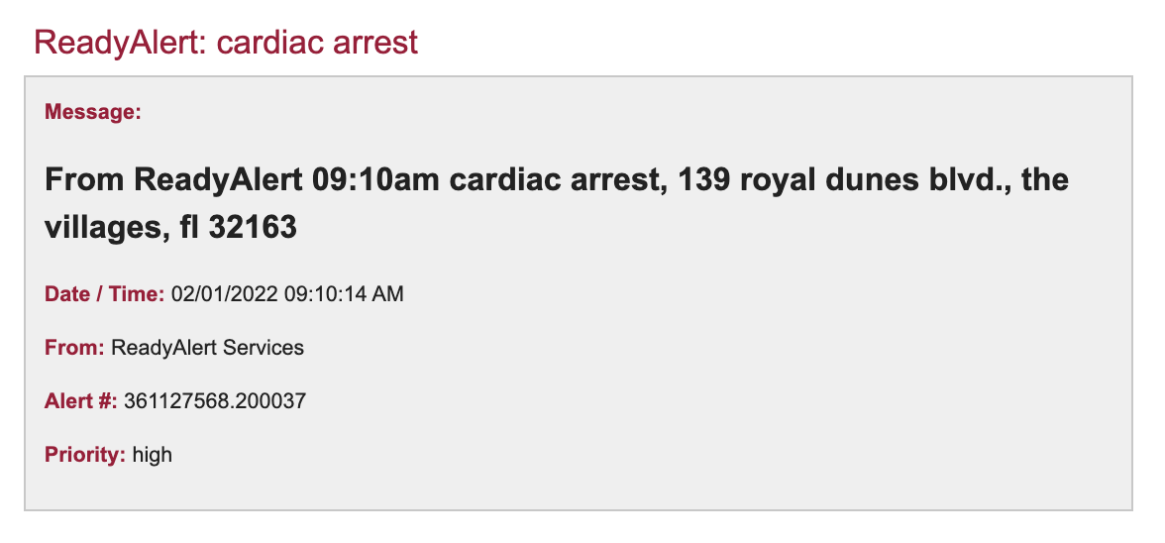
EMAIL

Slide 79
Maps will appear differently on an iPhone and Android phone, as well if the address opens in Apple maps or Google maps.

Slide 80
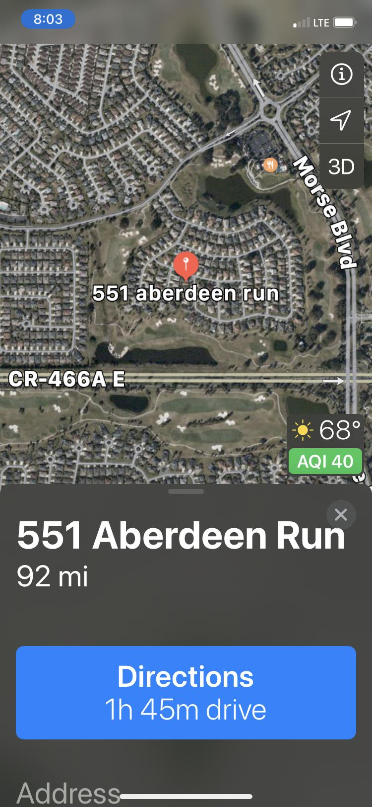

Slide 81
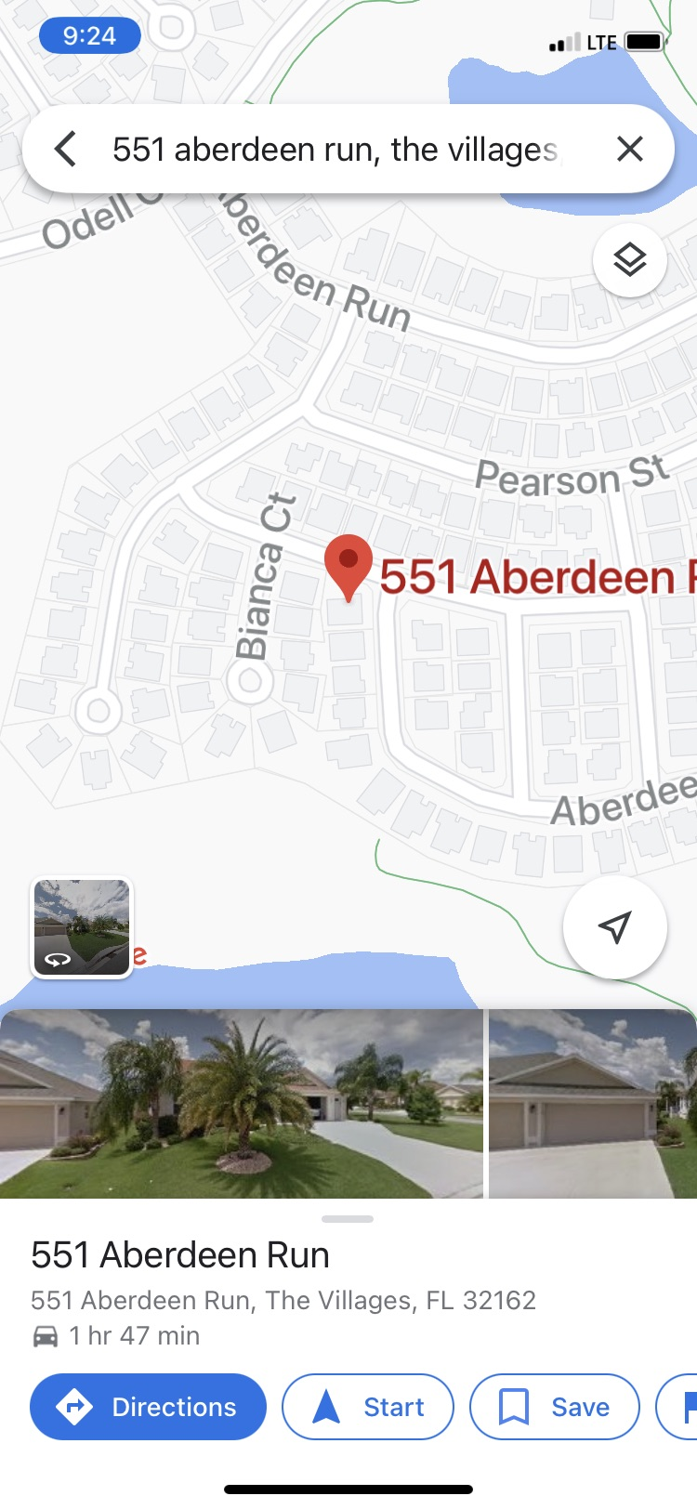

Slide 82
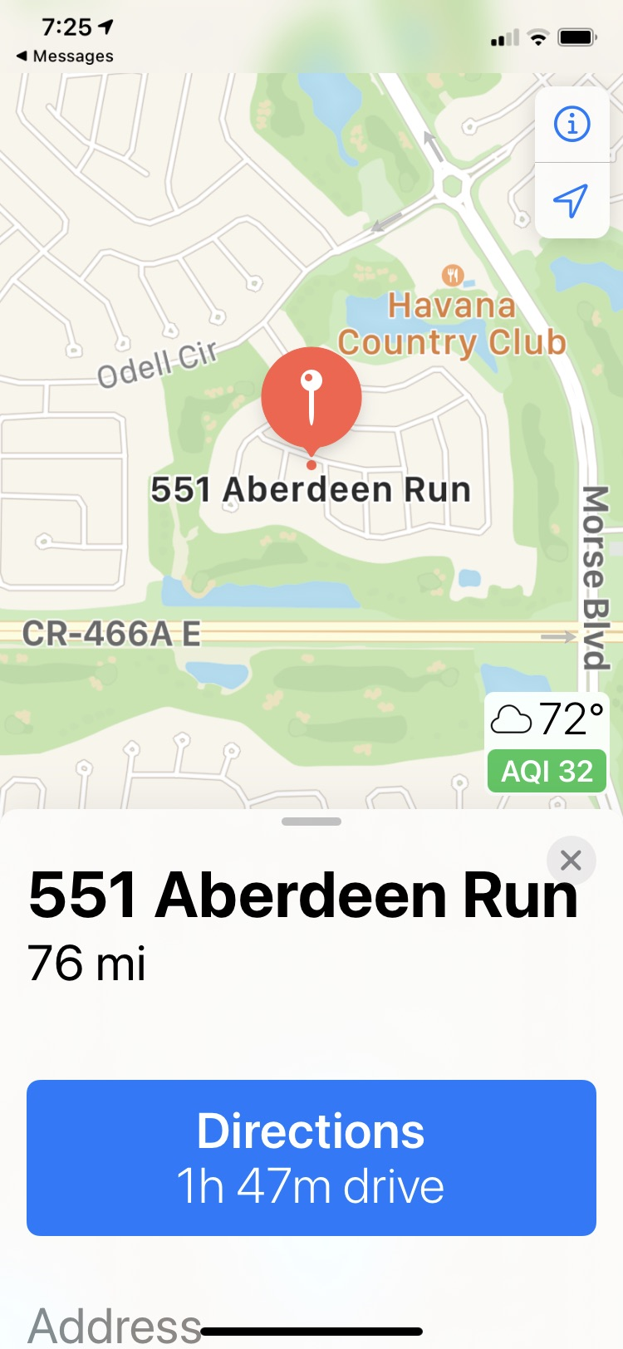

Slide 83
MONTHLY
REPORT

Slide 84
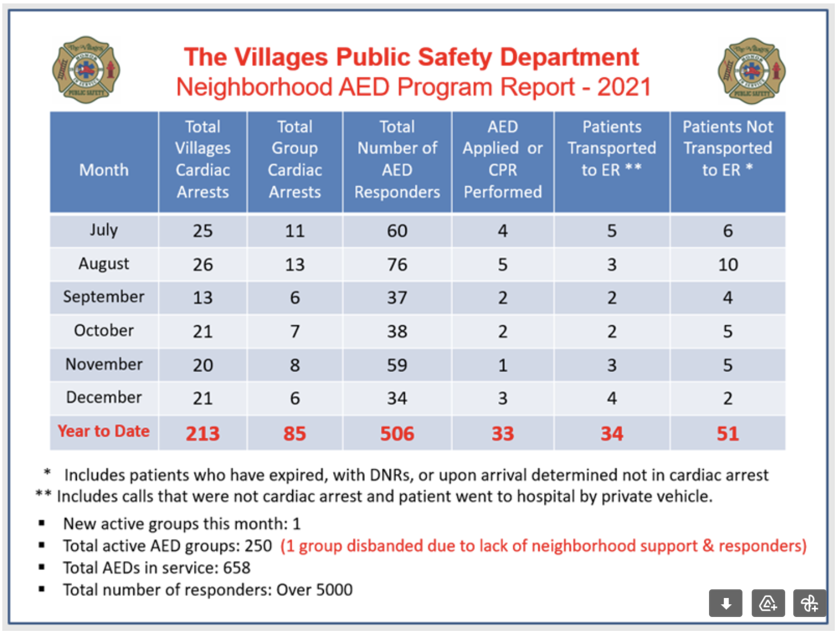

Slide 85
CARDIAC ARREST
REPORT

Slide 87
LOGISTICAL SUPPORT

Slide 88
Q: Who should coordinators contact about AED supplies?
Notes:
John and/or Norm

Slide 89
A: Go to – www.readyalertaed.com, click on AED battery and Pads Replacement.
Notes:
John and/or Norm

Slide 90
- If having difficulty, contact Bob Sjogren at Robert.sjogren@districtgov.org.
Notes:
John and/or Norm

Slide 91
FINANCIAL

Slide 92
Q: How does ReadyAlert invoice for notification service?

Slide 93
A: Coordinators their designee(s) are emailed an invoice the first week of the start of service.

Slide 94
Q: When is payment due?

Slide 95
A: Payment is due 30 days from the start of service period. A service period can be 12 or 24 months.

Slide 96
Q: How is billing determined?

Slide 97
A: By the number of responder households that a group has determined they want active at all times.

Slide 98
A: This number can be comprised of Primary and/or Alternate responder households.

Slide 99
Q: What is a “Primary” responder household?

Slide 100
A: A Primary responder household is a household that is charged for notification service.

Slide 101
Q: What is an “Alternate” responder household?

Slide 102
A: A trained responder(s) who temporarily fills in for a Primary responder household. There is no charge for an Alternate.

Slide 103
Q: Are seasonal Primary responder households charged while they are gone?
A: Yes.

Slide 104
Q: Is a credit issued for a Primary responder household that is deleted during the year?

Slide 105
A: Yes. A credit is issued on the next bill for the vacant month(s) remaining in the billing cycle.

Slide 106
Q: How does ReadyAlert charge for adding a Primary responder household(s) during the billing year?

Slide 107
A: The amount for the months for the additional responder(s) will be added on the next invoice.

Slide 108
Q: How is payment made to ReadyAlert for service?

Slide 109
A: There are two options; mail check to the address on the invoice; have the bank send a check.

Slide 110
ACCESSING YOUR READYALERT ACCOUNT

Slide 112
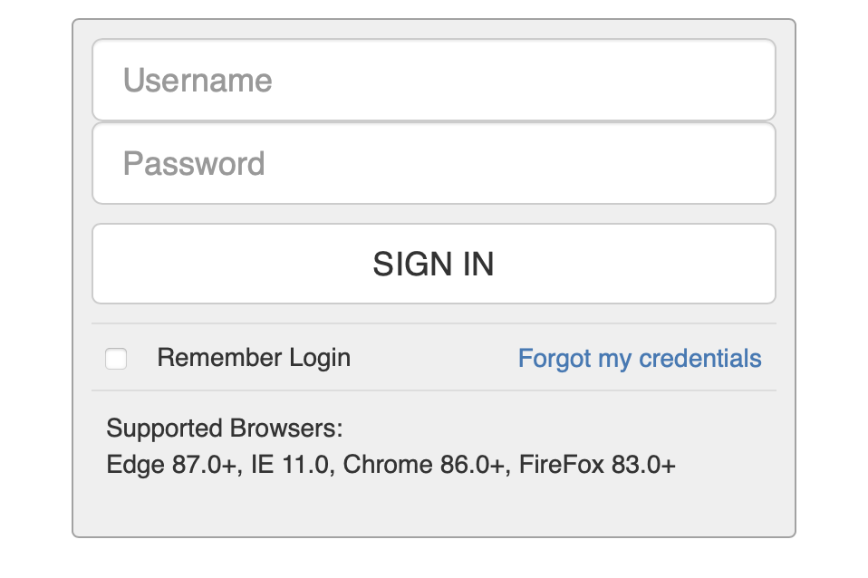
Add Username and Password (case-sensitive)

Slide 113
Forgot your login credentials? Click on Forgot my credentials

Slide 114
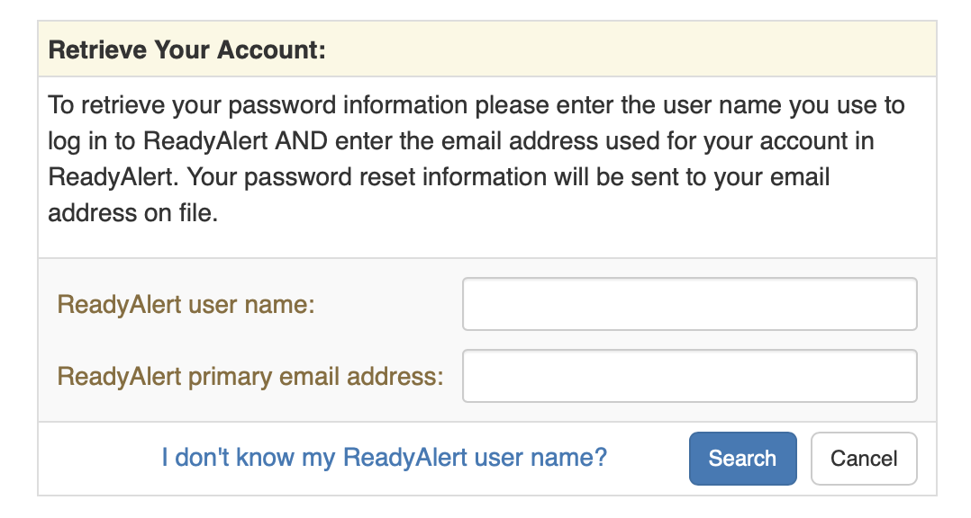

Slide 115
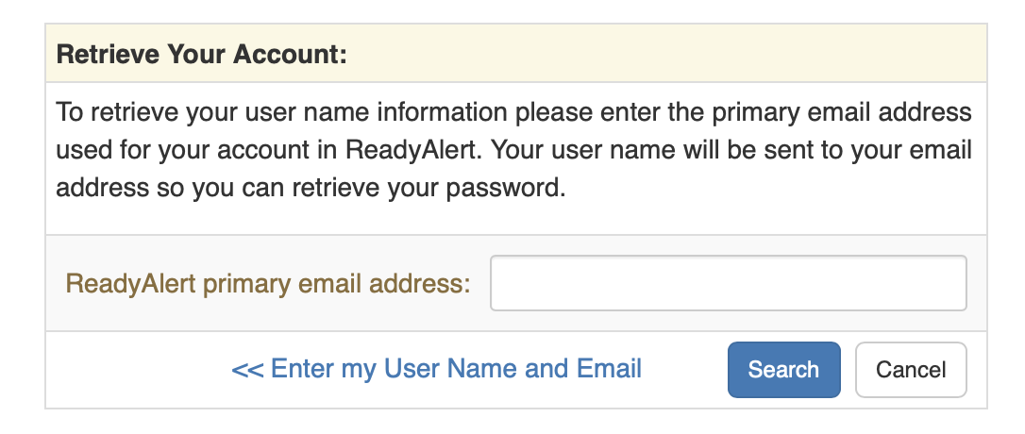
Retrieve Username -

Slide 116
Once you log into your account, you can search for your group and view information.

Slide 117
For changes, submit a support ticket at http://www.readyalertaed.com/support.php

Slide 118
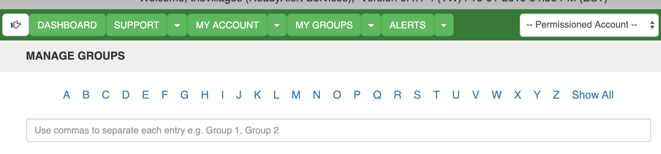
Click on the beginning letter of your group

Slide 119
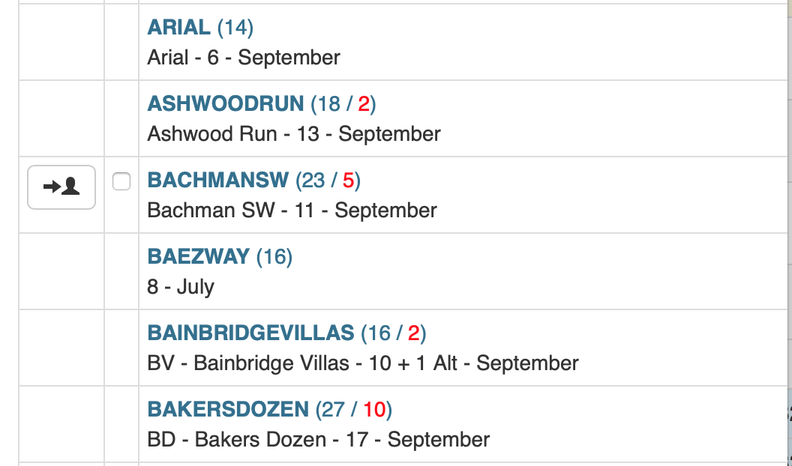

Slide 120
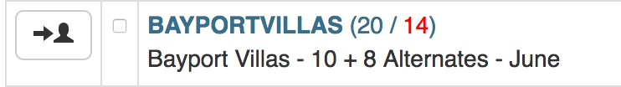
NUMBER OF PAID RESPONDER HOUSEHOLDS
NUMBER IN GROUP
NUMBER OF FREE RESPONDER HOUSEHOLDS
NUMBER OF SUSPENDED RESPONDERS
START OF BILLING CYCLE

Slide 121
Q: What is a RAID?

Slide 122
A: RAID stands for ReadyAlert ID. Each responder has his/her own unique RAID. In a household with two responders, the RAID number is the same, but the letter after the number is different, e.g. 20A, 20B.

Slide 123
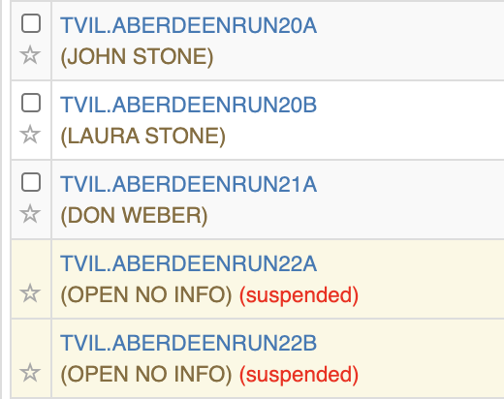

Slide 124
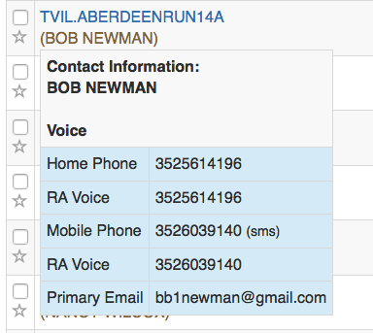
MOVE MOUSE OVER NAME

Slide 125
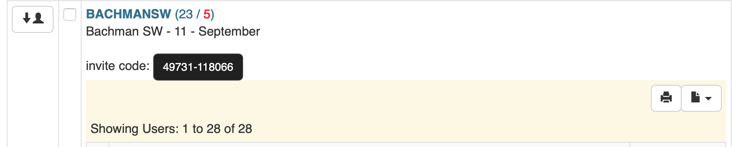
Print
Export
Notes:
TVIL.BAYPORTVILLAS00A

Slide 126
Export Report
The group data will be exported and downloaded automatically in .csv format. Be sure to save it as an Excel document.

Slide 127
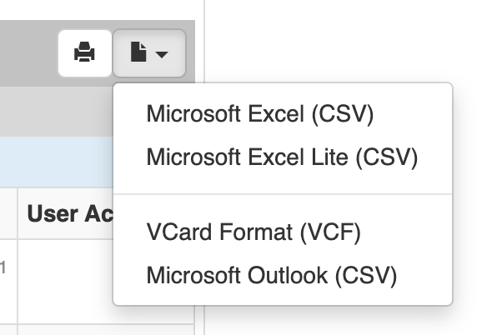

Slide 128
Any questions you can contact me at
larry@readyalert.com

